Slide 1
AFP ICON 2023
Elevate Your Fundraising Strategy with Career Intelligence

Slide 2
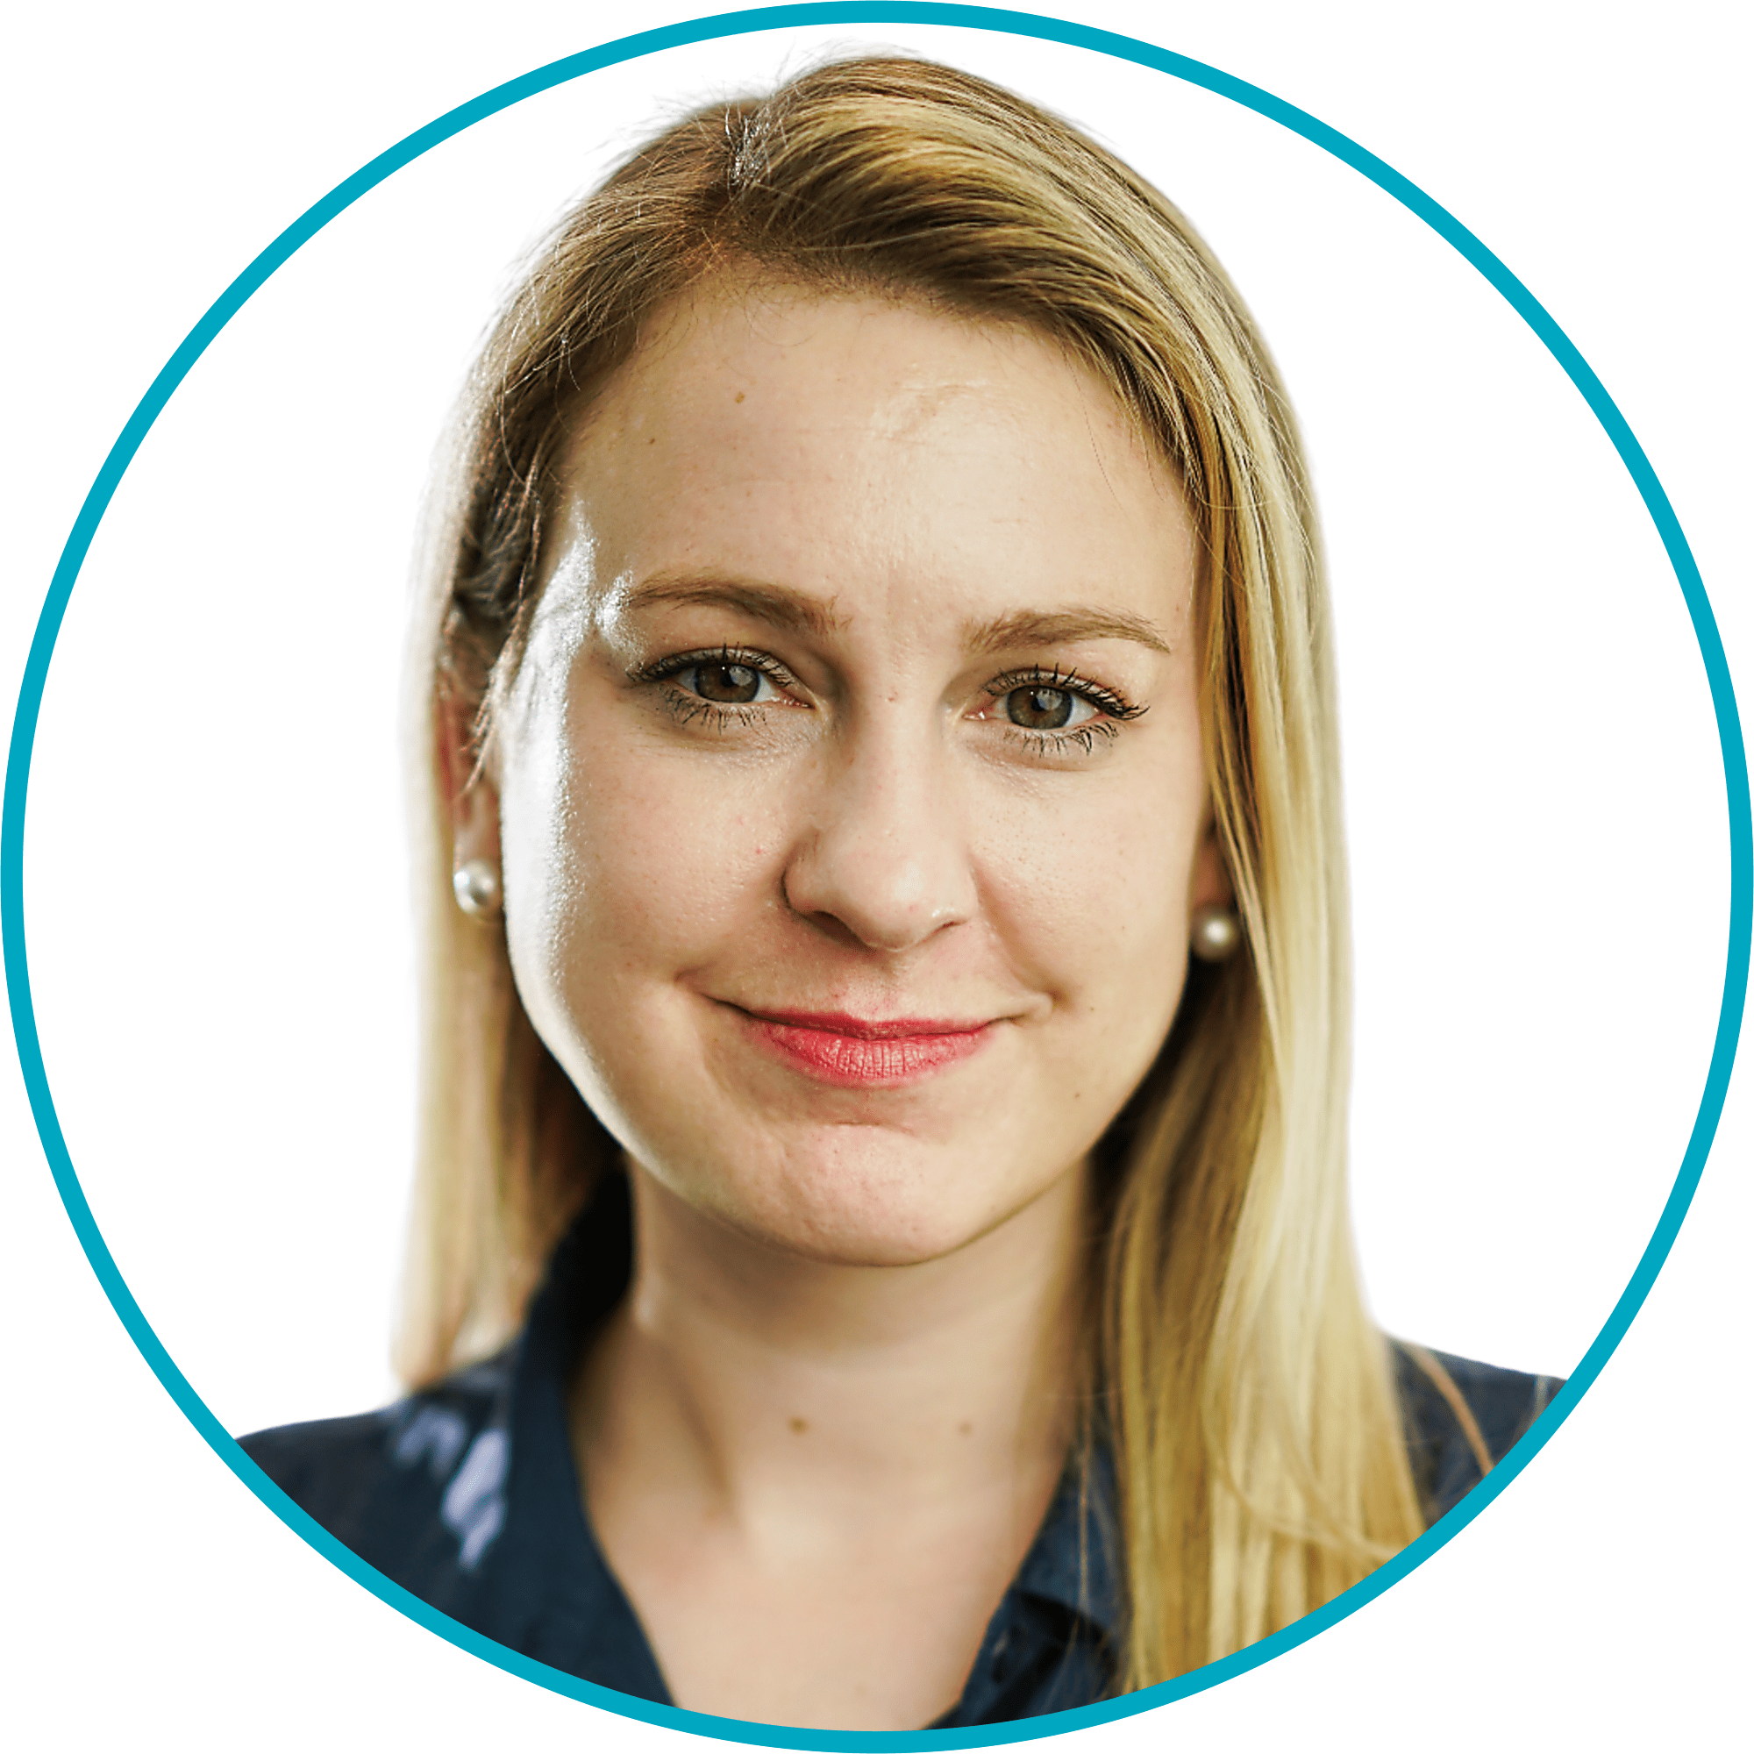
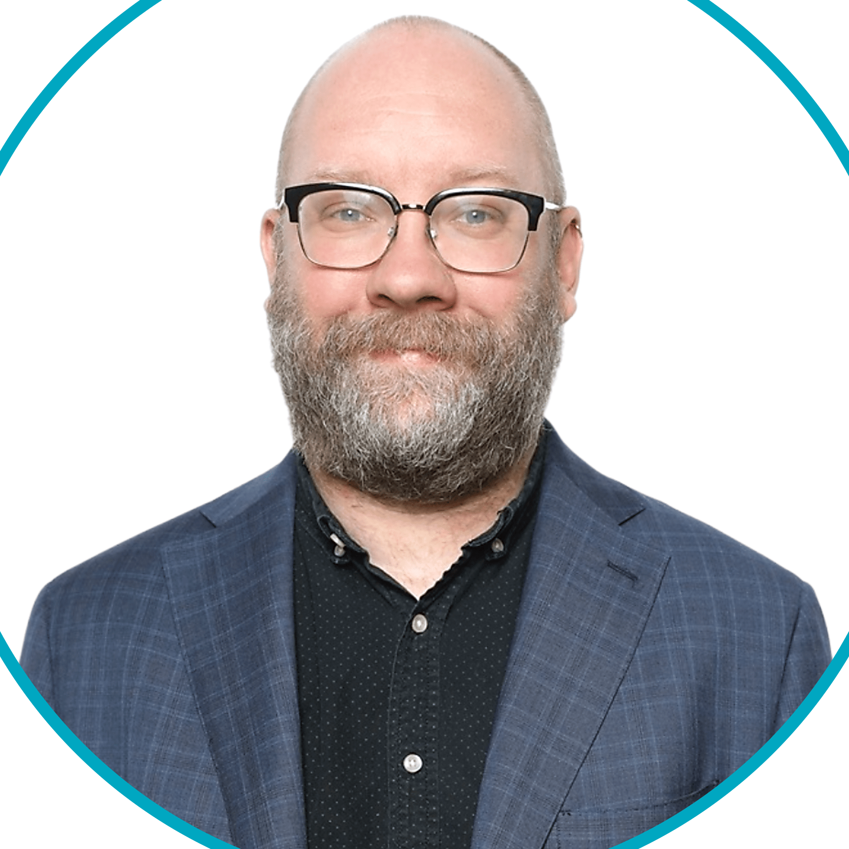
Speaker Introduction
Windfall Overview
Based in San Francisco, Windfall Data, Inc. is on a mission to help data-driven nonprofit organizations more effectively engage with constituents and donors through the accurate data and best-in-class propensity modeling.
18.1M+
90M+
Affluent households
US households
Marissa Maybee
Windfall
Director, Customer Success
marissa@windfall.com
Kyle Curry
Windfall
Director, Nonprofit Sales
kyle@windfall.com
800+
$71T+
Customers
Wealth in database
For more information visit www.windfall.com
Notes:
Test notes

Slide 3
Today’s Agenda
Windfall Overview
Supercharge Fundraising with Career Intelligence Data
Identifying Qualified Prospects
Segmentation for Outreach and Events
Determining How and When to Engage
Key Takeaways

Slide 4
Overview of Today’s Webinar
TARGET AUDIENCE: Development, advancement, and prospect research professionals who want to supercharge understanding of their constituents with career and employer data.
WHAT YOU WILL LEARN:
WHAT YOU WON’T LEARN:
Windfall’s mission and high level product offerings
The value of leveraging career data in outreach campaigns
Specific examples of how nonprofits can leverage career data in their outreach
The challenges with legacy career data
What makes our Career Intelligence data unique
Information on Windfall’s underlying wealth data
Our data science / modeling approach
How our data could impact your constituent database
A pricing and engagement strategy between Windfall / your organization
We are happy to discuss this with you after this presentation!

Slide 5
Windfall Overview

Slide 6
Our vision is to change the way that organizations understand and engage donors.

Slide 7
Windfall Empowers Nonprofits with Accurate Data
IDENTIFY
UNDERSTAND
ENGAGE
Find your highest valued donors and prospects to prioritize your overall development workflow.
Segment your existing donors and prospects to help convert “hidden gems.”
Either based on levels of wealth or Windfall’s triggers, figure out your engagement strategy.

Slide 8
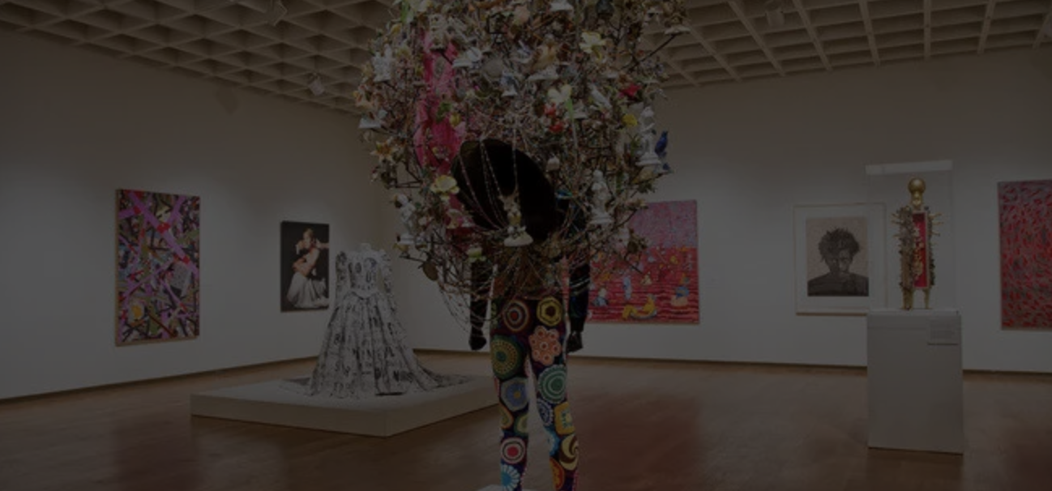
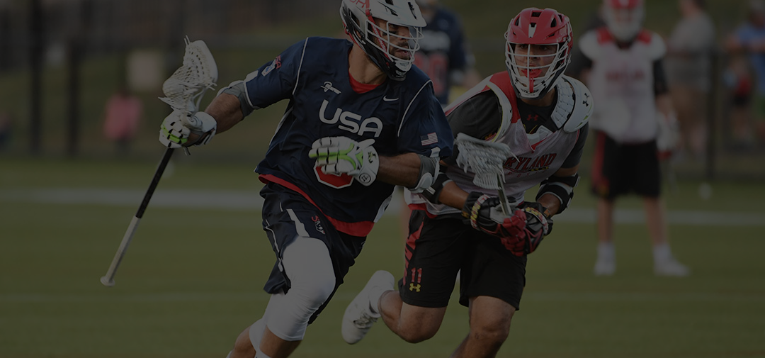
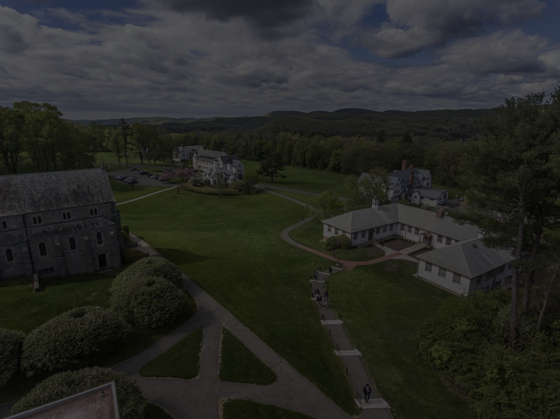
Trusted by 800+ Organizations Across the Country
WINDFALL IS LEVERAGED BY DATA-DRIVEN NONPROFIT ORGANIZATIONS OF ALL SIZES

Slide 9
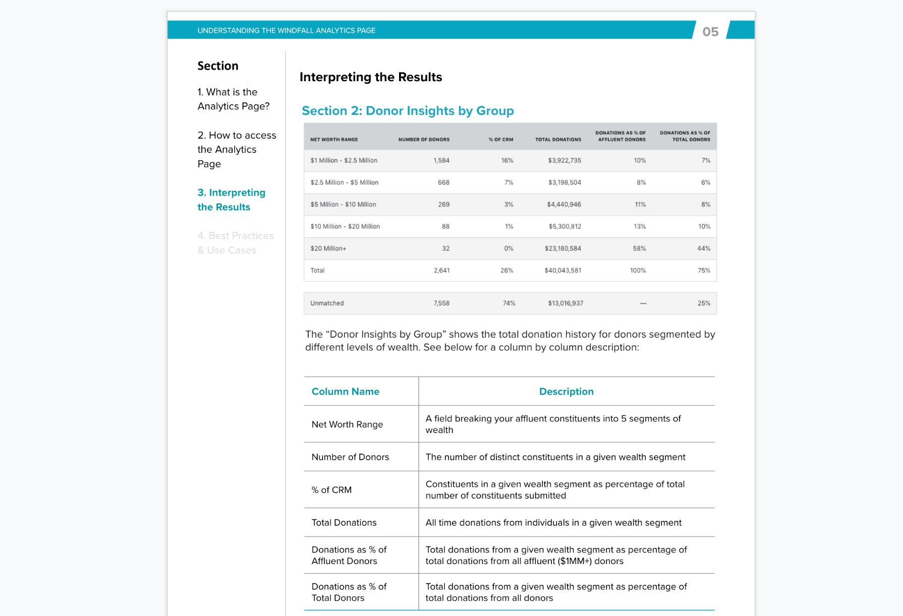
Dedicated Customer Success
& Best Practice Guides
Once you are a customer with Windfall, you will be assigned a dedicated Customer Success Manager. They will be responsible for: onboarding, providing guidance on data, support requests, and collecting your feedback.
WHAT YOU RECEIVE FROM CUSTOMER SUCCESS:
No automated bots: Speak with a human based in the United States.
24-hour response time: Get a response to your question via email or phone.
Best practice guides: Get access to Windfall’s best practice guides sourced from 800+ customers.
White glove service: We’ll make sure we don’t create more work for you.
‹#›

Slide 10
Windfall’s Nonprofit Solutions
WINDFALL WEALTH SCREENING
WINDFALL PROPENSITY TO GIVE
WINDFALL FOR NONPROFIT MARKETERS
Integrating into CRMs or working with CSVs, Windfall matches and appends data to constituent records
Custom propensity models, purpose built for your organization’s specific fundraising goals
Activate your data, and serve campaigns across social, digital and direct marketing channels with the Windfall Application & Programmatic DM
Enhanced with
Career Intelligence
All products are offered on a subscription basis, with flat fees and no variable costs

Slide 11
Supercharge Fundraising with Career Intelligence

Slide 12
Challenges with Legacy Career or Employment Data
Inaccurate matching
Only match against alma mater
Name
Name
Jane Smith
Gift Amount
Jane Smith
$500
Alma Mater
Alma Mater
Duke
Last Engagement Date
Duke
10/5/2020
WEALTH INSIGHTS
CAREER INSIGHTS
Charge by the record
Net Worth
$12.1MM
Job Title
CFO
Philanthropic
Yes
Job Level
C-Suite
Multi-property Owner
Yes
Company
Pharma Comp
Boat Owner
No
Company Size Range
1,001 - 5,000
Recent Move
Industry
Yes
Industry
32531: Pharma & Medicine
32531: Pharma & Medicine
Non-standardized industry

Slide 13
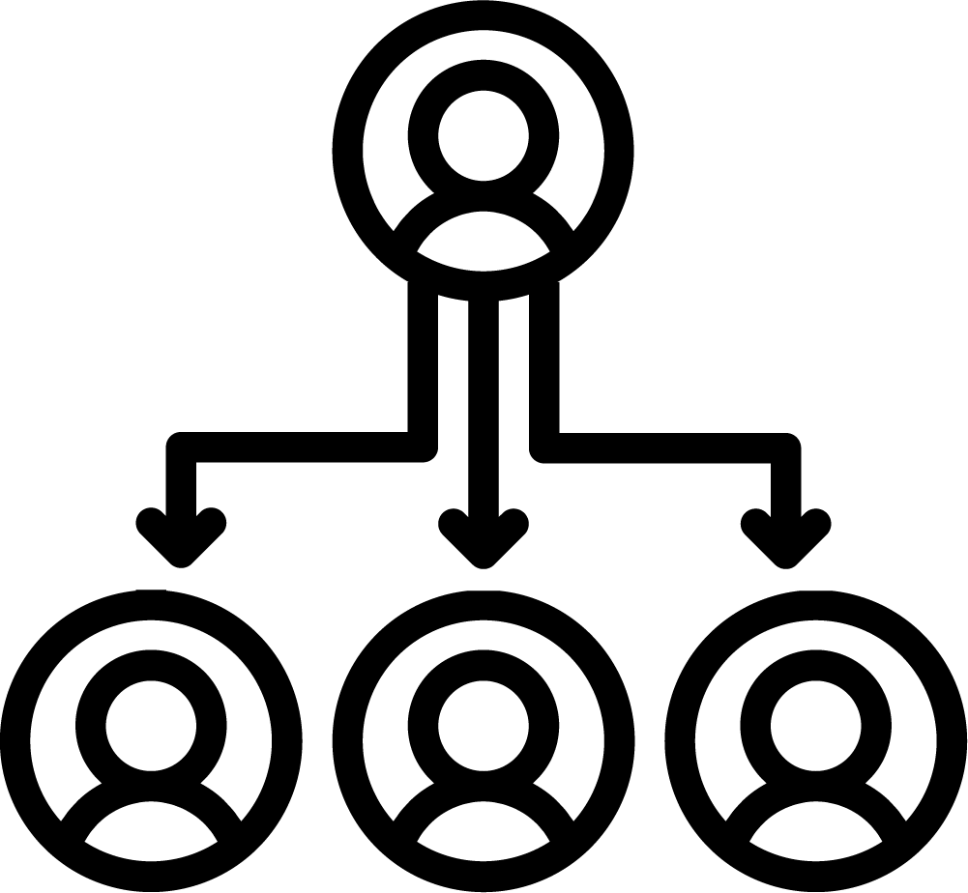
How Career Intelligence Data Can Help Your Nonprofit
PROVIDES A HOLISTIC VIEW OF CONSTITUENTS
INDICATOR OF AFFLUENCE AND INFLUENCE
TOOL FOR SEGMENTATION AND MESSAGING
Get more complete view of your constituents beyond affluence
Discover the donors who are leaders in their professional communities
Enhance how you cluster and message your constituents

Slide 14
Introducing:
Wealth Screening Premier
Windfall matches to your constituents and provides career data so you can improve prospect research and highlight trigger events for engagement.
This broader dataset is updated on a quarterly basis and is available to be enriched to customer’s data:
CAREER INTELLIGENCE FIELDS INCLUDED:
LinkedIn URL
Job Title
Job Level
Job Function
Job Start Date
Recently Changed Jobs Since Last Update
Company Name
Employment Data Match Confidence
Employment Last Updated Date
Company Domain
Company Phone Number
Company Address
Company City
Company State
Company Zip
Company NAICS Code
Company Size Range
Company Revenue Range
Source: Valassis, 2021

Slide 15
Windfall Business Model for Career Intelligence Data
LEVERAGE THE SAME DELIVERY PROCESS FOR WEALTH SCREENING FOR CAREER INTELLIGENCE DATA
UNLIMITED RECORD SYNCING
UPDATES & CHANGES
PRICING
We will sync ALL of your records as frequently as you’d like
We will supply updates for all the records we have, every time, and showcase any changes in jobs/title
The pricing follows our “all-you-can-eat” model so as your database grows, it doesn’t change the cost
Pricing is specific to your organization and other factors, including number of records / size of organization

Slide 16
Use Cases: Identifying
High-Value Constituents

Slide 17
Identify High-Value Prospects for Major Giving Programs
Predictor of potential of major giving when wealth data doesn’t cover an individual
Use to update ratings and move constituents in and out of gift officer portfolios
Job level that signals affluence: C-Suite
Net Worth
$12.1MM
N/A
$7.3MM
Philanthropic
Yes
N/A
Yes
Multi-property Owner
No
N/A
Yes
Recent Move
Yes
N/A
Yes
Job Title
CMO
CEO
CFO
Job Level
C-Suite
C-Suite
C-Suite
Employer
Realty Inc
Pharma Comp
Bankcorp

Slide 18
Identify Prospects for Mid-level Fundraising Programs and Future Giving Initiatives
May not be highly affluent but still qualify for other programs
Mid-level fundraising programs
Leadership gifts
Annual fund
Job levels that signal mid-level:
Vice President
Director or Senior Director
Net Worth
$1.1MM
$1.0M
N/A
Philanthropic
No
Yes
N/A
Multi-property Owner
Yes
Yes
N/A
Recent Move
No
Yes
N/A
Indicator of future affluence; cultivate “rising stars” as they move up the ladder
Job Title
Director of Strategy
Sr. Director of Product
VP of Marketing
Job Level
Director
Director, Senior
Vice President
Employer
CPG Inc
StartupTech
HomeGoods Corp

Slide 19
Identify Potential Board Members
and Champions
Career data shows who’s influential as well as affluent
Job levels that signal influence:
Director
Vice President
C-Suite
These titles may indicate that they’re good prospects for a board position
Retirement is a good trigger as well
Example: These titles can signal potential for being an alumni champion within their company for universities and colleges.

Slide 20
Use Cases: Segmentation for Outreach and Events

Slide 21
Segment Constituent Base for Different Campaigns and Outreach Initiatives
SEGMENT CONSTITUENTS
ENGAGE VIA UNIQUE OUTREACH PROGRAMS
Enrich stewardship, cultivation, and donor relations with custom programs based on career-related data
Refine messaging and to better match constituents’ career focus and interests
Improve segmentation, messaging, and performance via iteration
Constituent Database
COHORT 1: Employer has a Matching Gift Program
COHORT 1: Target in Matching Gift Campaign
COHORT 2: Work in Lucrative Industries (Tech, Finance, Pharma)
COHORT 2: Increase Annual Gift Ask
COHORT 3: Recently Changed Jobs
COHORT 3: Send A Congratulatory Note
COHORT 4:
Fit “Rising Star” Criteria
COHORT 4: Customize Annual Gift Ask and Messaging

Slide 22
Match Constituents to Volunteer Opportunities
Constituents can donate more than money - use career attributes to see which constituents are a good fit for volunteer programs.
Staff Accountant at a Local Business
Sr. Product Director at a Tech Startup
Freelance Social Media Manager
Bookkeeping Volunteer
Alumni Mentor - Engineering and Product
Digital Marketing and Social Media Volunteer

Slide 23
Segment Event Invitations Based on Career Attributes
Engineering
Networking Night
Use career data to invite the right constituents to the right events
Improve response rate and participation
Software Engineers
Nurse Practitioners
Speaker at a Healthcare Summit
Work at Company X
Events
Hosted at Company X

Slide 24
Use Cases: Determining How & When to Engage

Slide 25
Use Career Changes to Send Custom Messages
Development Director sends a handwritten congratulatory note and follows up with an ask a few weeks later
Constituent who hasn’t given in 5 years
...Gets a new job as a VP
Chief Development Officer gives them a call congratulating them on their retirement and asks them to serve on the nonprofit’s board
Affluent constituent
...Retires
...becomes CEO
at a Fortune 500 company
The Vice President of Advancement sends them a gift of swag and asks them to do a feature story for your newsletter or magazine
High-value donor

Slide 26
Customize Outreach Messaging Based on Career Attributes
EMPLOYER HAS A MATCHING GIFT PROGRAM
COMPANY RECENTLY WENT PUBLIC
JOB FUNCTION
= FINANCIAL
From: Mary Smith
To: Maureen Taylor
Subject: Matching Donations Today
From: Mary Smith
To: Dennis Jackson
Subject: Congratulations on IPO
From: Mary Smith
To: Frank Keaton
Subject: Invite - Be our teacher
Hello Maureen,
Did you know that your employer is matching donations to organizations like us?
Donate today and your gift will have 2x the impact!
Hi Dennis,
We saw that your startup had an extremely successful IPO! We’re so excited to see our alumni succeed.
Wishing you the best of luck!
Dear Frank,
We’re looking for community-oriented financial experts to volunteer as teachers for our Financial Literacy education program.
Would you be interested in sharing your expertise with those in need?
MAKE A GIFT!
WE ACCEPT STOCK GIFTS!
APPLY FOR A POSITION!

Slide 27
Other Ways We’ve Seen Nonprofits Use Career Data
Prospecting confirmation for major gift officers
Leveraging additional guidance on qualification if the underlying data isn’t enough
Using career changes to trigger outreach as part of stewardship and donor relations
Event and corporate fundraising support
Measuring alumni success rate within a profession or industry - recruitment & mentorship programs
Mapping constituent relationships
Identifying donations from employers & matching gifts
Notes:
-Creating alumni guidebooks to facilitate networking
-Identifying Corporate Sponsorship/Partnership targets
-Developing externship/mentorship programs and identifying event speakers
-Segmenting virtual event attendees by industry/interest
- May want to add or at least speak to the matching gift component. That gets people jazzed since it's often like "found money"!

Slide 28
Customer Win: Large University
DRIVING BETTER INSIGHTS AND ENGAGEMENT THROUGH CAREER INTELLIGENCE
~900
New, high-value alumni uncovered
185%
Increase in email response rates
25%
Increase in average gift size

Slide 29
Key Takeaways

Slide 30
Key Takeaways
Career data is a powerful tool to help nonprofits identify qualified donors and refine how they engage with all of their constituents
Use career and employer data to identify not only affluent constituents, but also the rising stars or constituents that are qualified for mid-level campaigns
Enhance segmentation with fields such as industry, employer, job function, and job level to better understand donors and refine outreach strategies
Personalize messaging and implement engagement triggers with career attributes and major events, such as getting a new job or retiring
Legacy career data has serious quality issues and you have to pay by the record. Windfall Career Intelligence Data is more accurate, scalable, and affordable

Slide 31
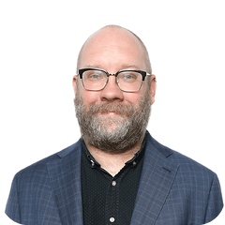
Marissa Maybee
Windfall
Principal CSM, Team Lead
marissa@windfall.com
Kyle Curry
Windfall
Sr. Director, Sales
kyle@windfall.com
Thank You!

